Slide 1
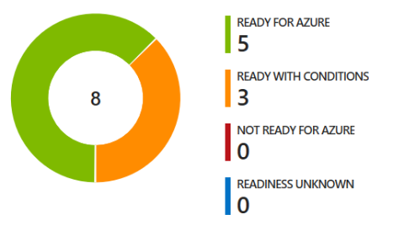












2
3
1
Azure Migrate Data Migration Assistant (DMA)
UbuntuWAF
UbuntuWAF
Azure Migrate
(Azure Site Recovery engine)
SmartHotelWeb1
SmartHotel On-premises
SmartHotelWeb1
SmartHotel Azure
SmartHotelHost
SmartHotelWeb2
SmartHotelWeb2
Azure Database Migration Service
SmartHotelSQL1
SmartHotelDB

Slide 2

Deploy to Azure

